Slide 1
Information Processing Techniques
Week 14
Abeeha Sattar

Slide 2
LINQ

Slide 3
What is LINQ?
Language Integrated Query
Make query a part of the language
Component of .NET Framework 3.5
Notes:
Key feature of C# 3.0 and VB 9

Slide 4
Query without LINQ
Objects using loops and conditions foreach(Customer c in customers) if (c.Region == “PAK") ...
Databases using SQL SELECT * FROM Customers WHERE Region=‘PAK'
XML using XPath/XQuery //Customers/Customer[@Region=‘PAK']
Notes:
This is the situation today, a different language for each technology.

Slide 5
ADO without LINQ
SqlConnection con = new SqlConnection(...);
con.Open();
SqlCommand cmd = new SqlCommand(
@"SELECT * FROM Customers
WHERE c.Region = @Region", con
);
cmd.Parameters.AddWithValue("@Region", “PAK");
DataReader dr = cmd.ExecuteReader();
while (dr.Read()) {
string name = dr.GetString(dr.GetOrdinal("Name"));
string phone = dr.GetString(dr.GetOrdinal("Phone"));
DateTime date = dr.GetDateTime(3);
}
dr.Close();
con.Close();
Notes:
Hard to write database-neutral SQL because of subtle variances in the parameters, escaping, types etc.

Slide 6
LINQ to…
LINQ to Objects
LINQ to SQL (formerly known as DLINQ)
LINQ to XML (formerly known as XLINQ)
LINQ to Entities (ADO.NET Entities)

Slide 7
Example
You have the following array. Return all numbers which are greater then 4.
Int[] Values = { 2,9,5,0,3,7,1,4,8,6};
Var filtered = from value in Values where value > 4 select value

Slide 8
Example
Our first LINQ query begins with a From clause which specifies a range variable (value) and the data source to query (the array values).
The range variable represents each item in the data source, much like the control variable in a For Each…Next statement.
If the condition in the Where clause evaluates to True, the element is selected—that is, it’s included in the collection of Integers that represents the query results.
Here, the Integers in the array are included only if they’re greater than 4.

Slide 9
Example (Sorting)
The LINQ query in the above example selects the elements of the array values and returns an IEnumerable object containing a sorted copy of the elements.
Int[] Values = { 2,9,5,0,3,7,1,4,8,6};
Var filtered = from value in Values Order By value select value

Slide 10
Query with LINQ (C#)
var myCustomers = from c in customers where c.Region == “PAK" select c;
Notes:
This is the same query in LINQ. You'll notice that the syntax is similar to SQL but with the select last. This is to facilitate IntelliSense - it needs to know what you are selecting from before it can offer what is available within that selection.

Slide 11
LINQ to ADO.Net
using (NorthwindDataContext db = new NorthwindDataContext())
{
//You can also use “var” at “IEnumerable<Customer>”
IEnumerable<Customer> custs = from c in db.Customers
select c;
foreach (Customer c in custs)
{
Console.WriteLine(c.CompanyName);
}
}

Slide 12
LINQ to XML
XElement xelement = XElement.Load("..\\..\\Employees.xml");
IEnumerable<XElement> employees = xelement.Elements();
// Read the entire XML
foreach (var employee in employees)
{
Console.WriteLine(employee);
}

Slide 13
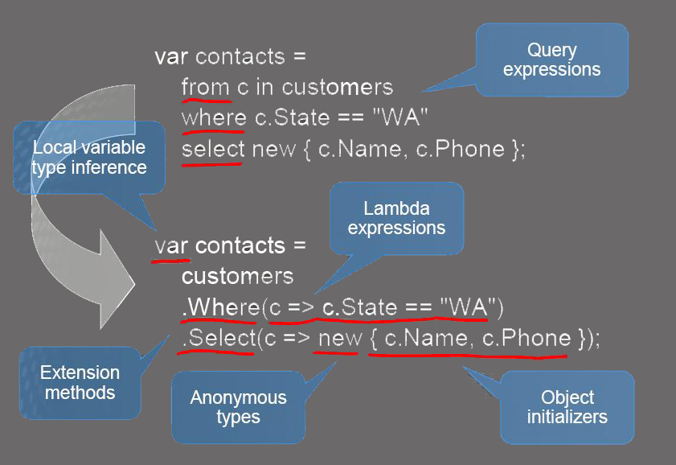
LINQ Prerequisite

Slide 14
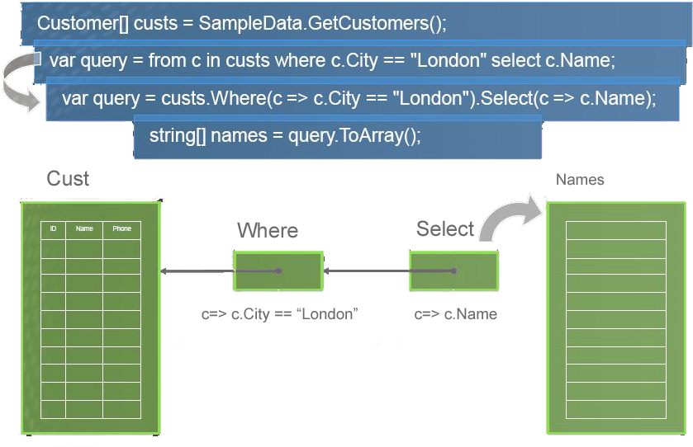
Deferred Query Execution

Slide 15
Advantages
Unified data access Single syntax to learn and remember
Strongly typed Catch errors during compilation
IntelliSense Prompt for syntax and attributes
Bindable result sets

Slide 16
Architecture
C#
VB.NET
Others
.NET Language Integrated Query (LINQ)
LINQ data source providers
ADO.NET support for LINQ
LINQ to Objects
LINQ to Datasets
LINQ to SQL
LINQ to Entities
LINQ to XML

Slide 17
LINQ to Objects
int[] nums = new int[] {0,4,2,6,3,8,3,1};
double average = nums.Take(6).Average(); var above = from n in nums where n > average select n;
Notes:
Average of first 6 numbers
And display all numbers above average

Slide 18
Querying an Array of Reference-Type Elements Using LINQ
When you type the name of an IEnumerable object (such as an array or the result of a LINQ query) then type the dot (.) separator, the list of the methods and properties that can be used with that object are shown.
Some of the methods are so-called extension methods.
For example, if you have an array of Doubles called numbers and you want to calculate the average of its values, you can simply call the Average extension method, as in numbers.Average().

Slide 19
LINQ to Objects
Query any IEnumerable<T> source Includes arrays, List<T>, Dictionary...
Many useful operators available Sum, Max, Min, Distinct, Intersect, Union
Expose your own data with IEnumerable<T> or IQueryable<T>
Create operators using extension methods

Slide 20
LINQ operators
Aggregate | Conversion | Ordering | Partitioning | Sets
Aggregate Average Count Max Min Sum | Cast OfType ToArray ToDictionary ToList ToLookup ToSequence | OrderBy ThenBy Descending Reverse | Skip SkipWhile Take TakeWhile | Concat Distinct Except Intersect Union
and many others

Slide 21
LINQ to SQL (formerly known as Dlinq)
Object-relational mapping Records become strongly-typed objects
Data context is the controller mechanism
Facilitates update, delete & insert
Translates LINQ queries behind the scenes
Type, parameter and injection safe

Slide 22
Limitations
LINQ
Only defines query, not update or context
LINQ To SQL
limited to SQL Server as backend
requires at least .NET 3.5 to run
somewhat limited in that tables are mapped strictly on a 1:1 basis (one table = one class)

Slide 23
.NET features used
.NET Framework 2.0
Partial classes (mapping)
.NET Framework 3.5
Anonymous types (shaping)
Extension methods (query operators)
Type inference (var keyword)
Lambda expressions (query syntax)

Slide 24
More LINQ queries
var goodCusts = (from c in db.Customers where c.PostCode.StartsWith(“PK") orderby c.Sales descending select (c).Skip(10).Take(10);

Slide 25
Fin.

